Slide 1
SQL Introduction
Lourdes Ovando
Software Developer working with data for over 10 years
Women Techmakers Modesto
March 19, 2020

Slide 2
Agenda
What is SQL?
What are some of the basic concepts?
Database
Table
Rows
Columns
What can I use SQL for?
What is the syntax for commonly used SQL operations?
Create
Insert
Update
Delete
Additional Concepts
Questions
https://github.com/ovando-lulu/wtm-modesto-intro-to-sql

Slide 3
What is SQL?
SQL stands for Structured Query Language
SQL is a language that allows you to access and manage relational databases
Communication with database

Slide 4
Basic Concepts
Relational Database
Data that is organized in tables with a defined relationship between tables
Table
Columns - Fields
Rows - Records

Slide 5
Basic Concepts Commands
SQL Commands that we will be using today
CREATE
SELECT
INSERT
UPDATE
DELETE

Slide 6
Basic Concepts DML and DDL
SQL Command are categorized:
Data Manipulation Language (DML) consists of the SQL commands used to work with the data inside of a database table
SELECT,INSERT, UPDATE, DELETE
Data Definition Language (DDL) consists of the SQL commands used to work structure of the database tables
CREATE, ALTER, DROP, RENAME, TRUNCATE

Slide 7
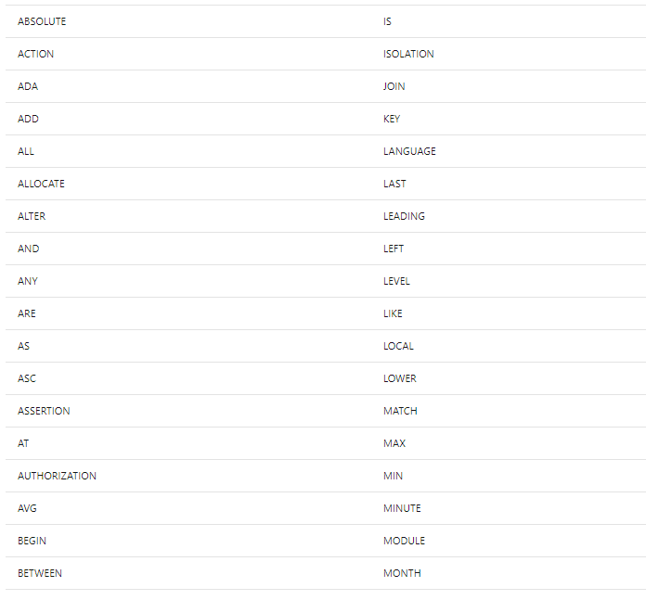
Basic Concepts Keywords
Reserved words that we will be using today
A complete list can be found in the documentation
CREATE
TABLE
DATABASE
SELECT
FROM
WHERE
DISTINCT
AND
OR
INSERT
INTO
UPDATE
FROM
WHERE
DELETE
FROM
WHERE
https://docs.microsoft.com/en-us/sql/odbc/reference/appendixes/reserved-keywords?view=sql-server-ver15

Slide 8
What can I use SQL for?
Store data into a database
Retrieve data
Modify and transform data
Manage database
The level of SQL functionality that you use will greatly depend on your role but can range from viewing data to designing and managing the database.

Slide 9
What jobs frequently list SQL as a desired skill?
Data Analyst
Typically uses DML to view data and find patterns
Data Engineer
Might use both DML and DDL to combine data from different sources and develop new derived data elements
Data Scientist
Might use both DML and DDL to transform the data and create machine learning models
Developer
Might use both DML and DDL to create, read, update and delete based on the software requirements
Database Developer
Typically uses DDL to design tables, stored procedures, views and functions
SQL is used across most industries

Slide 10
SQL Syntax
These are a few Relational Databases
IBM DB2
Microsoft Transact SQL (T-SQL)
MySQL
Oracle
PostgreSQL
Syntax and Reserved words for common operations are similar across relational databases
For this example we will be using a SQL online playground to practice Microsoft Transact SQL (T-SQL) syntax
http://sqlfiddle.com/

Slide 11
Let’s write some code!

Slide 12
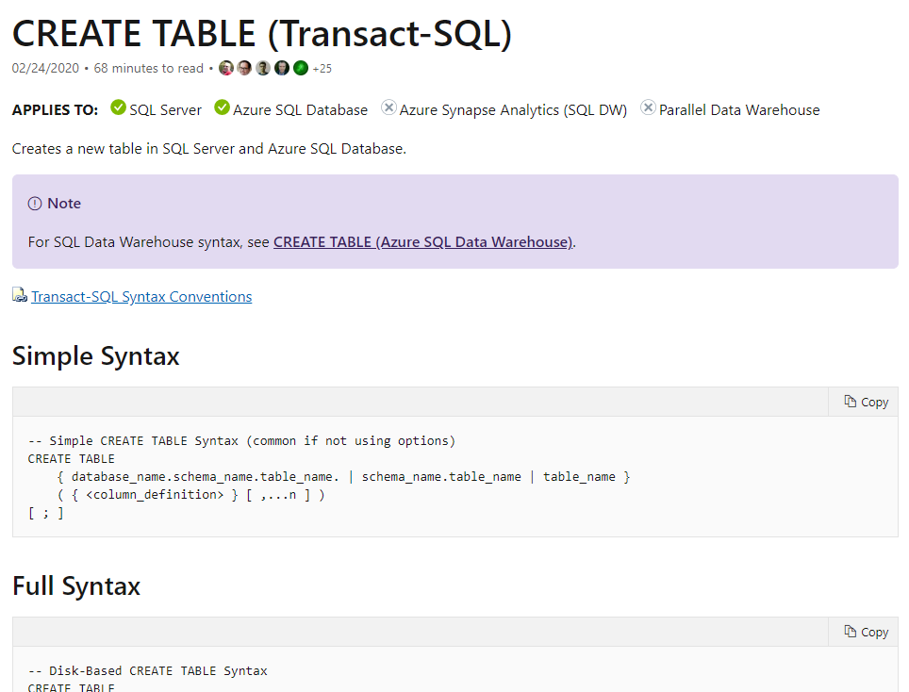
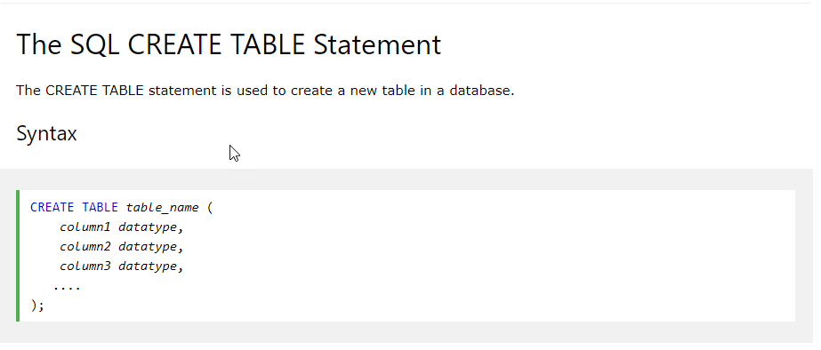
Create a table

Slide 13
Create a table
Use Case: We will be creating a relational database for an application that will be used at a bakery.
Creating the customer table
Create a table that stores the customers basic information
First name
Last name
Email address
Phone number
City
http://sqlfiddle.com/#!18/561042/1
Data types: https://docs.microsoft.com/en-us/sql/t-sql/data-types/data-types-transact-sql?view=sql-server-ver15

Slide 14
Create a table
CREATE TABLE customer
(
customerid int,
first_name varchar(100),
last_name varchar(100),
email_address varchar(100),
phone_number varchar(10),
city varchar(100)
);

Slide 15
Create a table
Use Case: We will be creating a relational database for an application that will be used at a bakery.
Creating the product table
Create a table that stores the available cakes
Flavor
Size
Filling
Color
Design
Price

Slide 16
Create a table
Use Case: We will be creating a relational database for an application that will be used at a bakery.
Creating the orders table
Create a table that stores the cake orders
Customer
Product
Order Date
Status

Slide 17
Create a table
CREATE TABLE customer
( customerid int,
first_name varchar(100),
last_name varchar(100),
email_address varchar(100),
phone_number varchar(10),
city varchar(100)
);
CREATE TABLE product
( productid int,
flavor varchar(100),
size varchar(100),
filling varchar(100),
design varchar(10),
price smallmoney
);
CREATE TABLE orders
( customerid varchar(100),
productid varchar(100),
order_date datetime,
status varchar(10)
);
http://sqlfiddle.com/#!18/e79ceb

Slide 18
DEMO
INSERT
UPDATE
DELETE
http://sqlfiddle.com/#!18/16314a/5

Slide 19
Additional Concepts
DML for Data Analysis
DDL
Case statements
Aggregation
Joins
Subqueries
Views
pivot
Alter table
Drop

Slide 20
Questions
Thank you for your time!
Thank you Women Techmakers Modesto!
Connect with me on LinkedIn!
https://www.linkedin.com/in/lourdesovando/

Slide 21
References
http://sqlfiddle.com/
https://docs.microsoft.com/en-us/sql/odbc/reference/appendixes/reserved-keywords?view=sql-server-ver15

